Slide 1
Super steak
Yo man

Slide 2
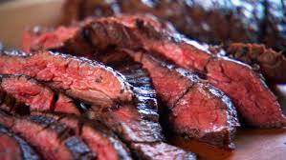
We are steak!

Slide 3
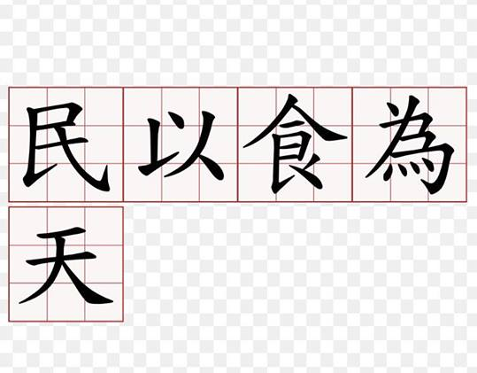
Topic :Bread is the staff of life: )

Slide 4
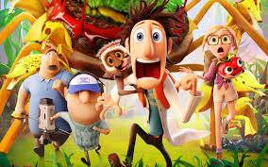
Member introduction : hi everyone

Slide 5
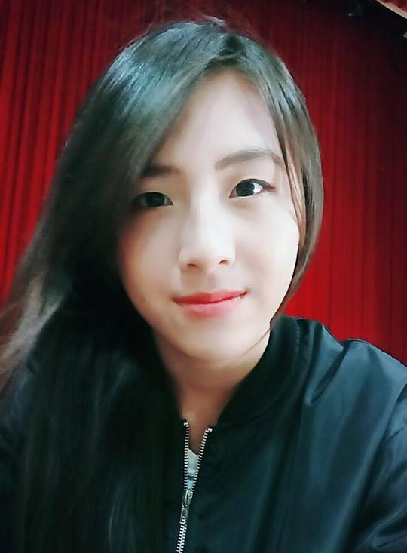
Member 1:lu lu

Slide 6
Dance(Jazz)
Have a lot of information
The highest girl in our class
From Taichung
Sometimes wear glasses
Instagram :lulu_wakana

Slide 7
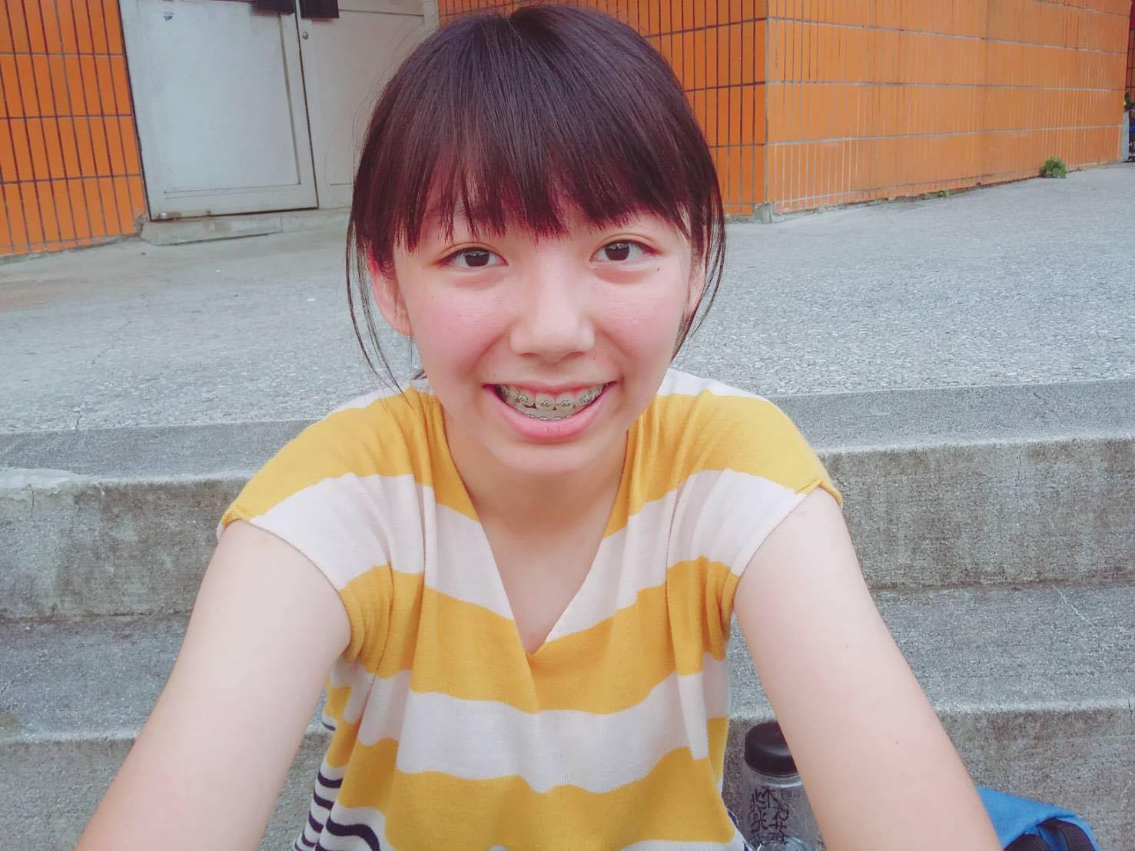
Member 2: Zhan Yiting
smile

Slide 8
Playing basketball well
Have some Intrinsic humor
Mobile game leader
From Taoyuan
Aquarius
Instagram :0217_yi_ting

Slide 9

Member 3: Tai Yu wen
(me)

Slide 10
Nice person
163cm/53kg
Leo
From Taipei
Instagram :lamfishman
English class with Zhan Yiting

Slide 11
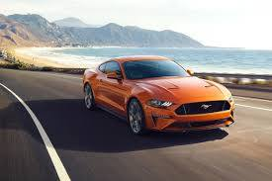
Member 4:

Slide 12
188cm
The most handsome person in our team.
Go to school by driving car .
Provide computer for us
From Taipei
Instagram :tommy_hsu1117

Slide 13
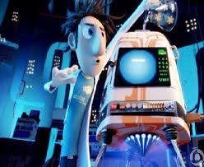
Concept : food machine!

Slide 14

Look at the video! https://youtu.be/KJ-Y3-yP0J0

Slide 15

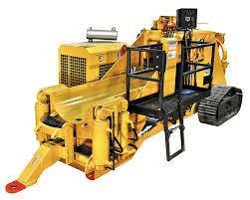
Manufacturing method:

Slide 16

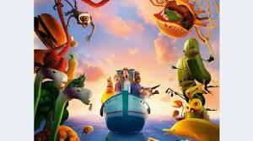
And then ……..

Slide 17
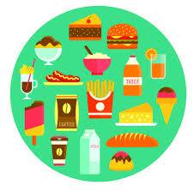
We have !

Slide 18

We want to solve some problem : (

Slide 19
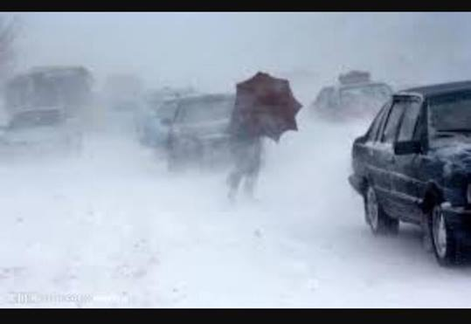
Problem 1: The weather is bad

Slide 20
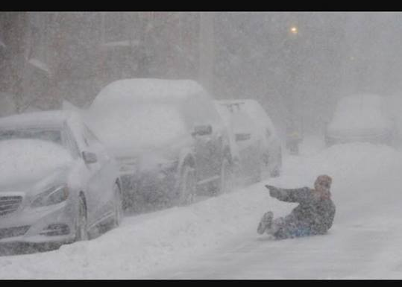
If we have this machine ……

Slide 21
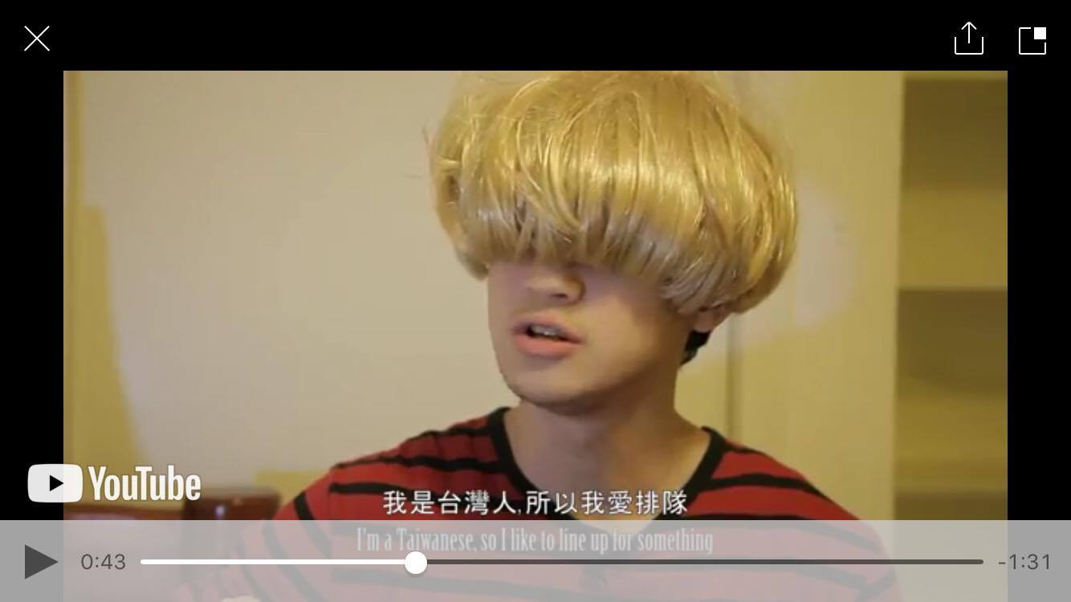
Problem 2: Spend a lot of time lining up

Slide 22
I am a Taiwanese ,so I like to line up for something!

Slide 23
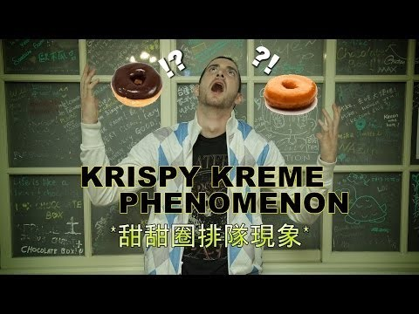
https://youtu.be/J5KVtGijU0c
(if we have time )

Slide 24
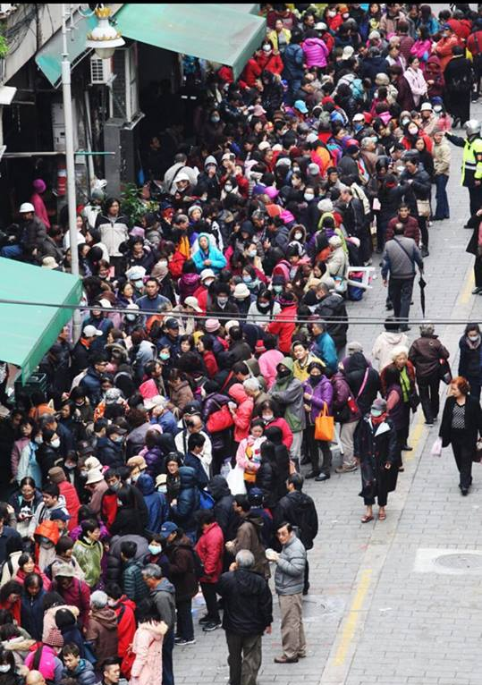
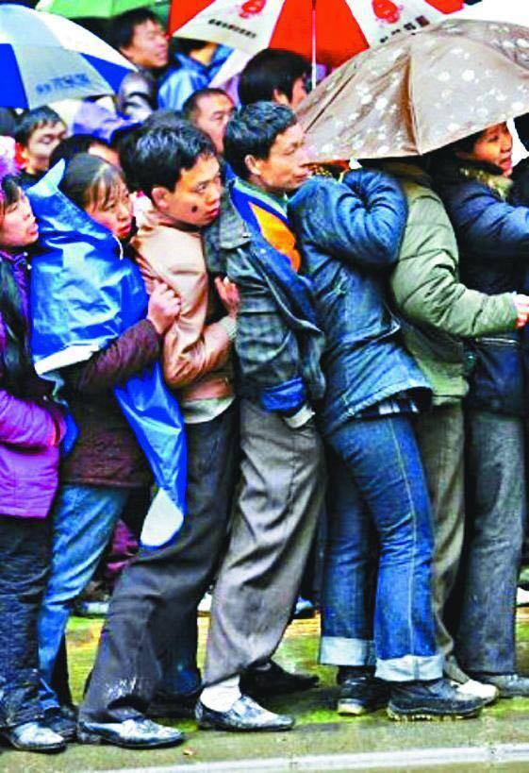

Slide 25
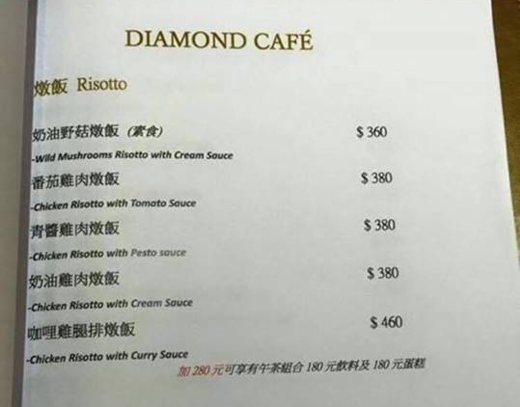
Problem 3 :
Outside food is too expensive

Slide 26
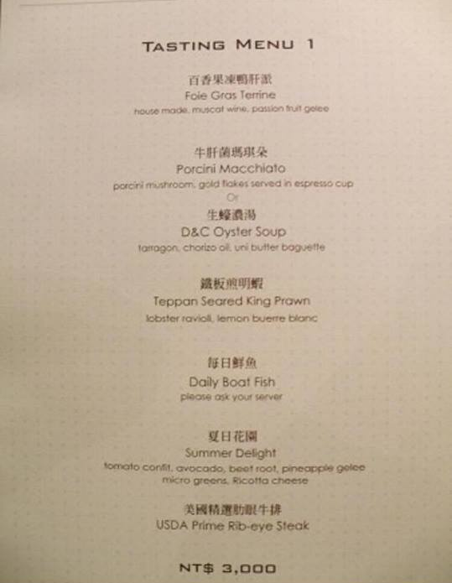
Wow

Slide 27
If we have this machine :
We just have some water .

Slide 28
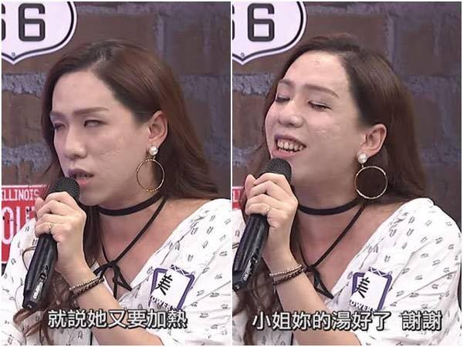
Problem 4 :Clerk is too fierce and motorcycle

Slide 29
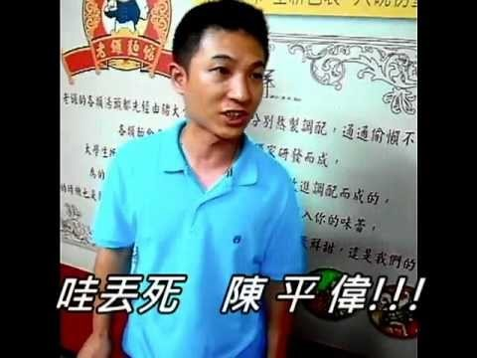
https://youtu.be/ZRk-h4SissU
(if we have time )

Slide 30
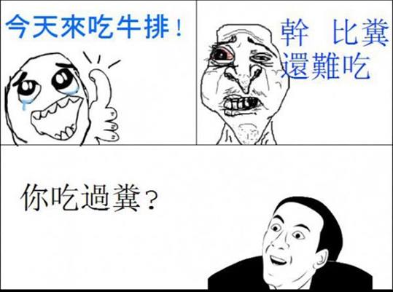
Problem 5 : delicious or not
Today we are going to eat some steak.
Fxxk!
More difficult
than stool.
Have you eaten stool?

Slide 31
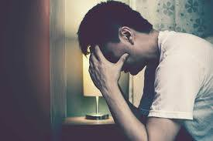
We can not predict : (

Slide 32
At last

Slide 33

We recommend a game :
Start playing!

Slide 34

Thank you for listening!

